Slide 1

DATABASE DEVELOPMENT OF BOOSTER MAINENANCE
STRIKE TEAM ALPHA
MADHUGIRI YASH
RAO TUSHAR
LI YUKAI
BHALEKAR PIYUSH

Slide 2
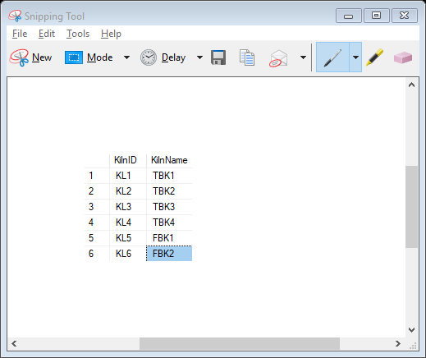
Kiln Table DDL
CREATE TABLE Kiln
( KilnID char(3) not null,
KilnName varchar(5),
CONSTRAINT Kiln_PK primary key (KilnID) );
-- TBK : Three Booster Kiln
-- FBK : Four Booster Kiln
--Total Number of Kilns : 6

Slide 3
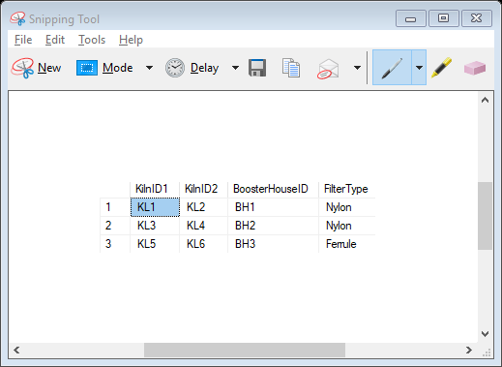
Booster House DDL
CREATE TABLE BoosterHouse
(KilnID1 char(3) not null,
KilnID2 char(3) not null,
BoosterHouseID char(3) not null,
FilterType varchar(10),
CONSTRAINT FilterType_CHK CHECK(FilterType='Nylon' or FilterType='Ferrule'),
CONSTRAINT BoosterHouse_PK PRIMARY KEY (BoosterHouseID),
CONSTRAINT BoosterHouse_FK1 FOREIGN KEY (KilnID1) references Kiln(KilnID),
CONSTRAINT BoosterHouse_FK2 FOREIGN KEY (KilnID2) REFERENCES Kiln(KilnID));
Total Booster Houses : 3
Two types of Filters : Nylon and Ferrule

Slide 4
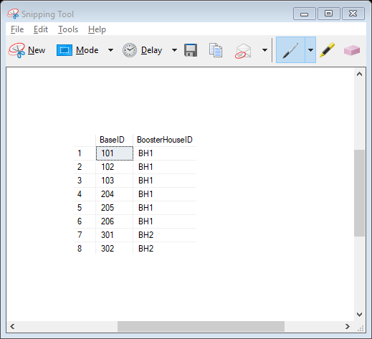
Booster Base DDL
CREATE TABLE Booster_Base
( BaseID int not null,
BoosterHouseID char(3) not null,
CONSTRAINT Base_PK PRIMARY KEY (BaseID),
CONSTRAINT Base_FK FOREIGN KEY (BoosterHouseID)
references BoosterHouse(BoosterHouseID) );
Total 20 Booster Bases
1 Booster/ Booster Base

Slide 5
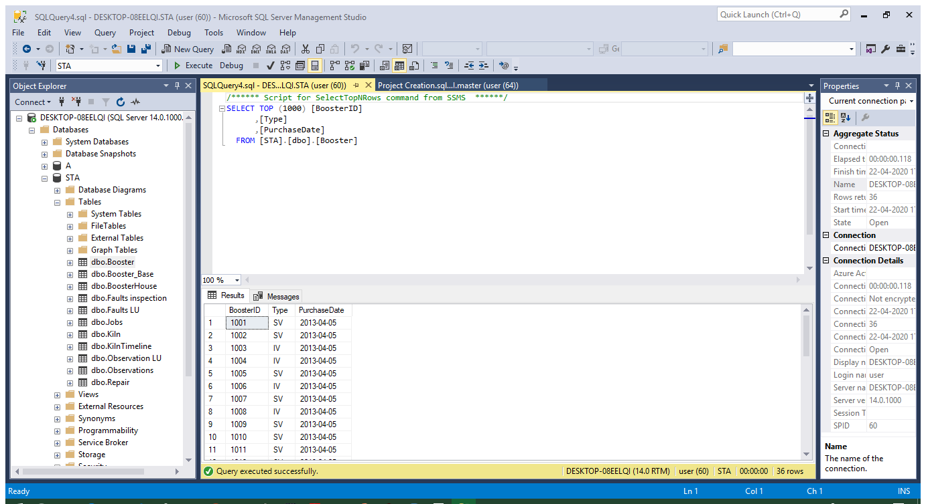
Booster DDL
CREATE TABLE Booster
( BoosterID char(4) not null,
[Type] char(2) ,
PurchaseDate date,
CONSTRAINT Type_CHK CHECK([Type]='SV' or [Type]='IV'),
CONSTRAINT Booster_PK PRIMARY KEY (BoosterID) );
Total Boosters : 38
Two types : Straight Vane (SV) , Inclined Vane (IV)

Slide 6
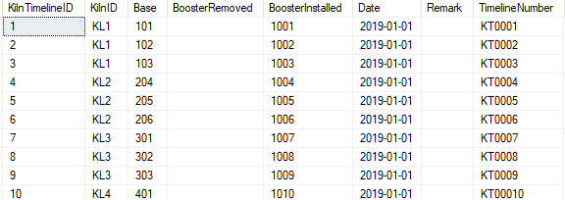
Kiln Timeline DDL
CREATE TABLE KilnTimeline
(KilnTimelineID int not null PRIMARY KEY IDENTITY (1,1) ,
KilnID char(3) not null,
Base char(3)not null,
BoosterRemoved char(4),
BoosterInstalled char(4),
[Date] date not null,
Remark varchar(100),
CONSTRAINT KilnTimeline_FK1 FOREIGN KEY (KilnID) references Kiln(KilnID),
TimelineNumber AS 'KT' + RIGHT('000'+cast(KilnTimelineID as varchar(7)),7));
Dynamic Table : Generated when anomaly is detected in control room

Slide 7
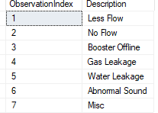
Observations Lookup DDL
CREATE TABLE [dbo].[Observation LU](
[ObservationIndex] [numeric](5, 0) PRIMARY KEY ,
[Description] [varchar](50) NULL)

Slide 8
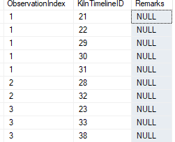
Observations DDL
CREATE TABLE Observations
( ObservationIndex int not null,
KilnTimelineID int not null ,
Remarks varchar(50),
CONSTRAINT Observations_FK FOREIGN KEY (KilnTimelineID) REFERENCES KilnTimeline(KilnTimelineID),
CONSTRAINT Observations_PK PRIMARY KEY ( ObservationIndex, KilnTimelineID));
Dynamic Table updated during changing of Boosters on the Booster base

Slide 9
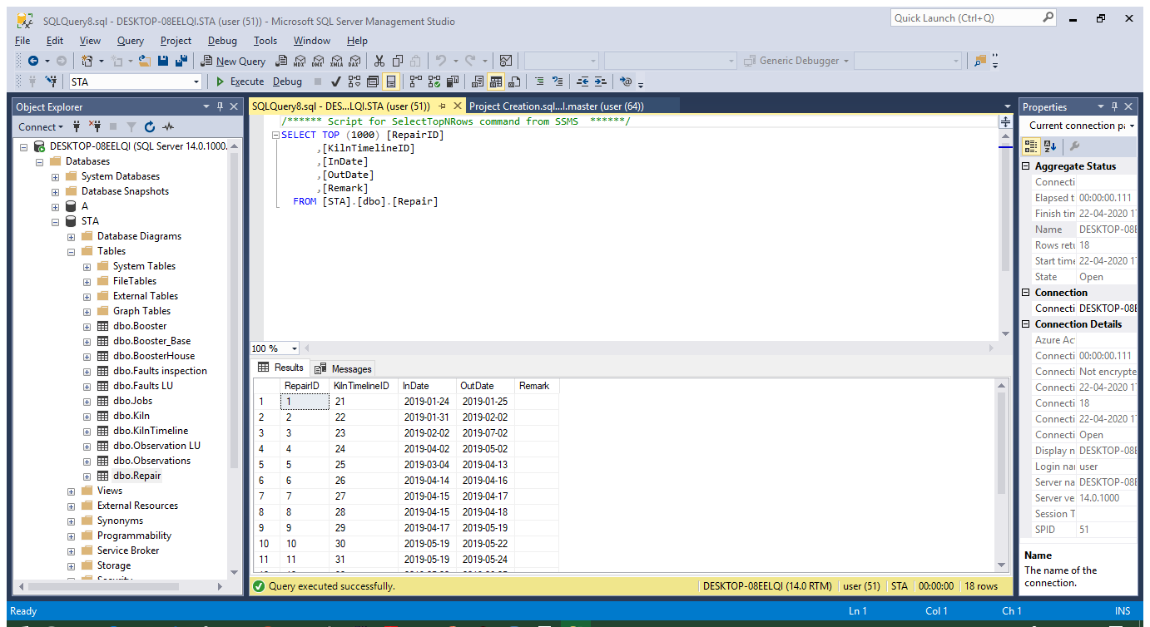
Repair DDL
CREATE TABLE Repair
(RepairID int not null IDENTITY(1,1),
KilnTimelineID int not null ,
InDate date not null,
OutDate date,
Remark varchar(50),
CONSTRAINT Repair_FK FOREIGN KEY (KilnTimelineID) REFERENCES KilnTimeline(KilnTimelineID),
CONSTRAINT Repair_PK PRIMARY KEY (RepairID));
Table Updates when
1. Booster is delivered to repair shop after failure
2. When repairing is done and the job is “ Complete”

Slide 10
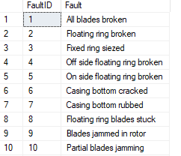
Faults Lookup DDL
CREATE TABLE [Faults LU]
(FaultID int not null PRIMARY KEY,
Fault varchar(50));
26 known part faults , plus a Misc. for an unusual fault , accompany with remark in the FAULTS INSEPCTION TABLE

Slide 11
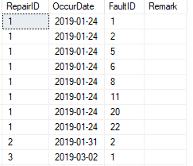
Faults Inspection DDL ( list)
CREATE TABLE [Faults inspection]
(RepairID int not null,
OccurDate date,
FaultID int not null,
Remark varchar(100),
CONSTRAINT [Faults inspection_FK] FOREIGN KEY (RepairID) REFERENCES [Repair](RepairID),
CONSTRAINT [Faults inspection_PK] PRIMARY KEY (RepairID, FaultID) );
Dynamic table , Can be looked upon like a list, updated when the part is dissembled and inspected for faults

Slide 12

Jobs DDL ( List)
CREATE TABLE Jobs
( RepairID int not null,
JobIndex int not null,
JobDone varchar(50) not null,
[Date]date NOT NULL,
[Hours] int not null,
Remark varchar(50),
CONSTRAINT Jobs_FK FOREIGN KEY (RepairID) REFERENCES Repair(RepairID),
CONSTRAINT Jobs_PK PRIMARY KEY (JobIndex, RepairID));
A job sheet, all the jobs performed for a repairing will be noted here. The date of the job named ‘ Complete’ is noted as the OutDate for a particular repair ( Trigger takes care)
That’s when a Repair is considered as ‘completed’

Slide 13
Procedures BoosterRecord
CREATE PROCEDURE BoosterRecord @BoosterID char(4)
as
BEGIN
SET NOCOUNT ON
SELECT kt.BoosterRemoved as BoosterID, b.[Type], r.RepairID, r.OutDate as [Repair Completed On], k.KilnName, ol.[Description]
FROM KilnTimeline kt
JOIN Observations o
ON kt.KilnTimelineID=o.KilnTimelineID
JOIN [Observation LU] ol
ON o.ObservationIndex=ol.ObservationIndex
JOIN Kiln k
ON kt.KilnID=k.KilnID
JOIN Booster b
ON kt.BoosterRemoved = b.BoosterID
JOIN Repair r
ON kt.KilnTimelineID = r.KilnTimelineID
WHERE kt.BoosterRemoved=@BoosterID
END;
EXEC BoosterRecord @BoosterID='1020'
This procedure is aiming to check the repairing history of a booster. We input the Booster ID and get the details including type of the booster, the repair ID, the date of repair completed, the name of the kiln and other descriptions.

Slide 14

Procedures KilnRecord
CREATE PROCEDURE KilnRecord @KilnID char(3)
as
BEGIN
SET NOCOUNT ON
SELECT kt.TimelineNumber, kt.KilnID, k.KilnName, kt.BoosterRemoved, b.[Type], o.ObservationIndex, ol.[Description]
FROM KilnTimeline kt JOIN Observations o
ON kt.KilnTimelineID=o.KilnTimelineID
JOIN [Observation LU] ol
ON o.ObservationIndex=OL.ObservationIndex
JOIN Booster b
ON kt.BoosterRemoved = b.BoosterID
JOIN Kiln k
ON kt.KilnID=k.KilnID
WHERE kt.KilnID = @KilnID
END;
--EXEC KilnRecord @KilnID='KL2'
This procedure is aiming to pull up observation timelines for a particular kiln. We input the ID of the kiln and get the list including the name of the kiln, the ID of boosters of the kiln, the type of boosters, the observation index and other descriptions.

Slide 15
Procedures Repairing
CREATE PROCEDURE Repairing @Checkdate date
as
BEGIN
SELECT kt.BoosterRemoved as BoosterID, kt.Base, b.[Type] as BoosterType, r.InDate, ol.[Description]
FROM Repair r
JOIN KilnTimeline kt
ON kt.KilnTimelineID=r.KilnTimelineID
JOIN Observations o
ON o.KilnTimelineID=r.KilnTimelineID
JOIN [Observation LU] ol
ON ol.ObservationIndex=o.ObservationIndex
JOIN Booster b
ON kt.BoosterRemoved = b.BoosterID
where (Indate<=@Checkdate and Outdate IS NULL) or (Indate<=@Checkdate and Outdate>=@checkdate)
END;
--EXEC Repairing @Checkdate='2019-05-20'
This procedure is aiming to check the repairing booster on a specific date. We input the date and get the ID of boosters which are repairing, the type of boosters, the date when boosters start repairing and other descriptions.

Slide 16
VIEW RepairShopSummary
CREATE VIEW RepairShopSummary AS
SELECT KilnTimeline.BoosterRemoved,Repair.RepairID,
Repair.InDate,Repair.OutDate ,DATEDIFF(day, Repair.InDate,Repair.OutDate) AS [Repair(days)] FROM
KilnTimeline Right outer JOIN Repair ON KilnTimeline.KilnTimelineID=Repair.KilnTimelineID
--SELECT * FROM RepairShopSummary
This view is for pulling up all booster repair records. We will get the information including ID of repairing booster, repair ID, the start date and end date of repairing and the repair time.

Slide 17
VIEW Summary
CREATE VIEW Summary AS
SELECT KilnTimeline.KilnID,KilnTimeline.Base,
KilnTimeline.BoosterRemoved,KilnTimeline.BoosterInstalled,
KilnTimeline.KilnTimelineID,[Observation LU].[Description],
Repair.RepairID,Repair.InDate,Repair.OutDate,Repair.Remark,
DATEDIFF(day,Repair.InDate,Repair.OutDate) AS [Repair(days)]
FROM KilnTimeline
JOIN Observations ON KilnTimeline.KilnTimelineID = Observations.KilnTimelineID
JOIN [Observation LU] ON Observations.ObservationIndex = [Observation LU].ObservationIndex
JOIN Repair ON Repair.KilnTimelineID= KilnTimeline.KilnTimelineID
--SELECT * FROM Summary
This view is for pulling up the summary of the entire project data. The information include kilns, bases, kiln timeline, repairing and so on.

Slide 18
Trigger OutDateCatchtrg
CREATE TRIGGER dbo.OutDateCatchtrg ON Jobs
AFTER INSERT
AS BEGIN
INSERT INTO OutDateCatch
(RepairID,JobIndex,JobDone,[Date],[Hours],Remark)
SELECT RepairID, JobIndex,JobDone,[Date],[Hours],Remark FROM inserted
WHERE JobDone='Complete'
END

Slide 19
Trigger OutDateTrg
CREATE TRIGGER OutDateTrg on OutDateCatch
AFTER INSERT
AS BEGIN
INSERT INTO DUMMY (KilnTimelineID, RepairID, InDate, OutDate)
SELECT r.KilnTimelineID ,r.RepairID,r.InDate,o.[Date] AS OutDate
FROM Repair r
RIGHT JOIN OutDateCatch o
ON r.RepairID=o.RepairID
GROUP BY r.KilnTimelineID,r.RepairID, r.InDate,o.[Date]
UPDATE Repair
SET Repair.OutDate = DUMMY.OutDate
FROM Repair
lefT JOIN DUMMY
ON Repair.RepairID = DUMMY.RepairID
END
This trigger is to update the end date of repairing of the booster. We insert the repair ID, the start date and end date of the repairing and update the end date in the original data.

